Slide 1


Vision and Perception: Deep Learning project
Noiseprint: a CNN-based camera model fingerprint
Fabrizio Casadei Edoardo Papa

Slide 2

Introduction: digital image forensics
In the last few years the image forensics has been achieving an ever increasing attention in the scientific community and beyond.
Media like photos and videos have become a dominant source of information, not always used for good purposes.
Therefore, image and video manipulations are becoming very common and dangerous.
In the last decade, a large number of methods have been proposed for forgery detection and localization or camera identification.
PRNU (photo-response non-uniformity) methods.

Slide 3


The Goal in pills:
Camera models left noisy traces on the images, that are used in forensic analyses.
Such traces represent a sort of camera fingerprint.
Therefore, each image has an intrinsic uniform amount of noise introduced by the imaging process or by digital compression.
Using the Noiseprint method it’s possible to detect forgeries.
The Noiseprint technique reaches great performance compared with other methods.

Slide 4
What has been done:
Retrieved a part of the original dataset used in the paper.
Compressed the JPEG dataset with quality level: 31% (high compression)
Created and saved an H5 file that contains all the patches of dataset images
Created the convolutional neural network model
Performed the training step
Obtained Noiseprint image results on the test set
Forensic similarity Classifier to detect spliced images
Evaluation through metrics like accuracy,F1,MCC

Slide 5
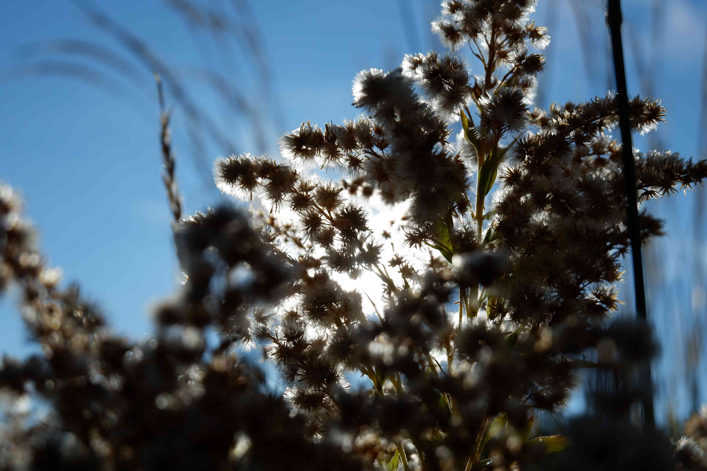
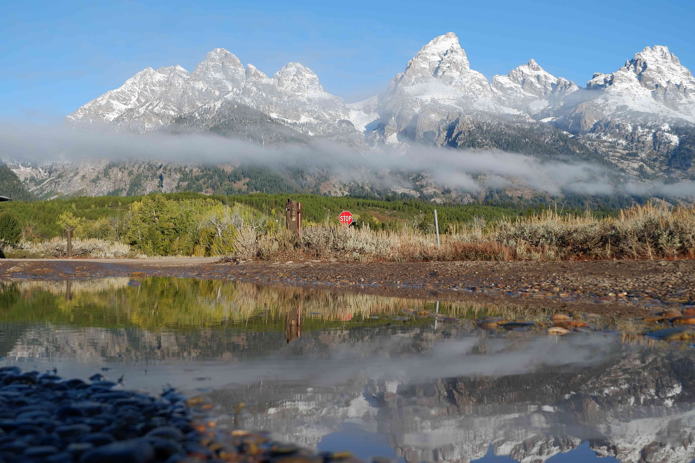
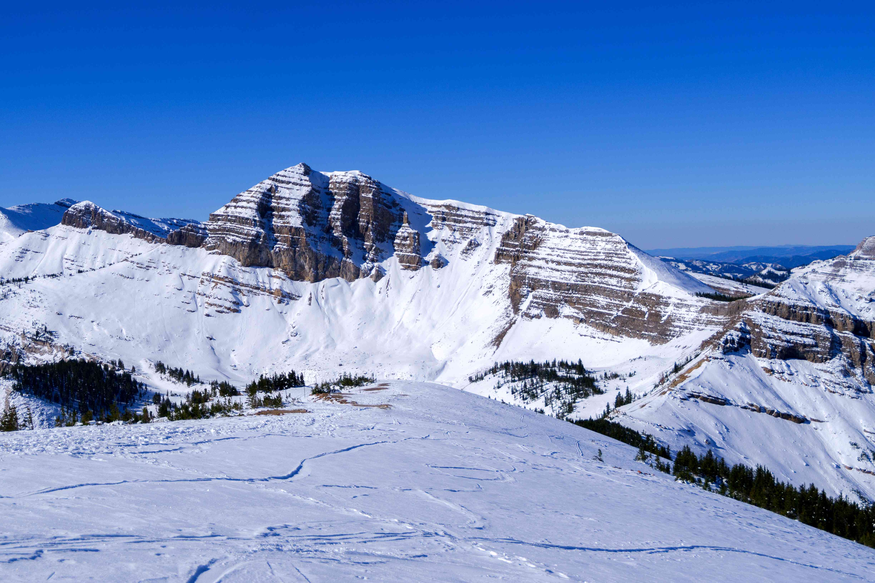
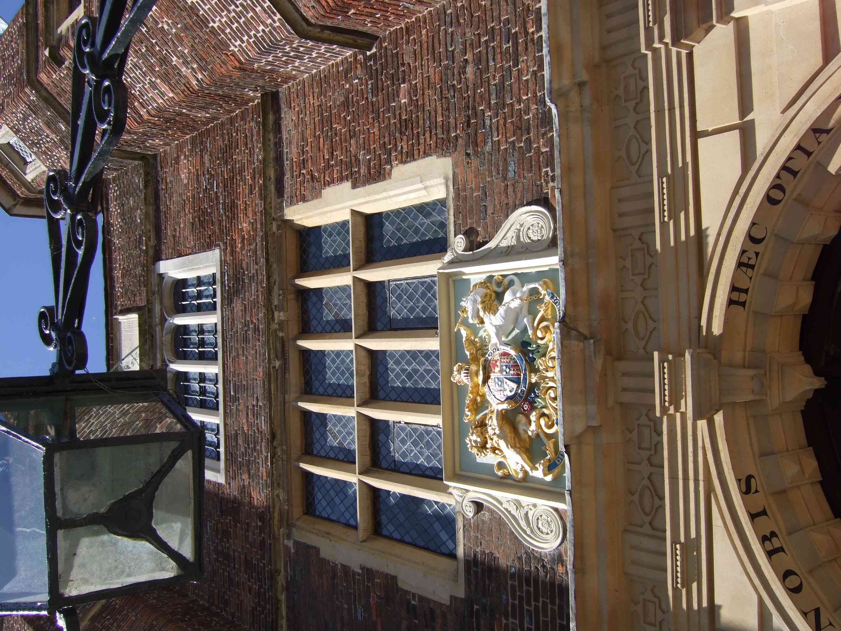
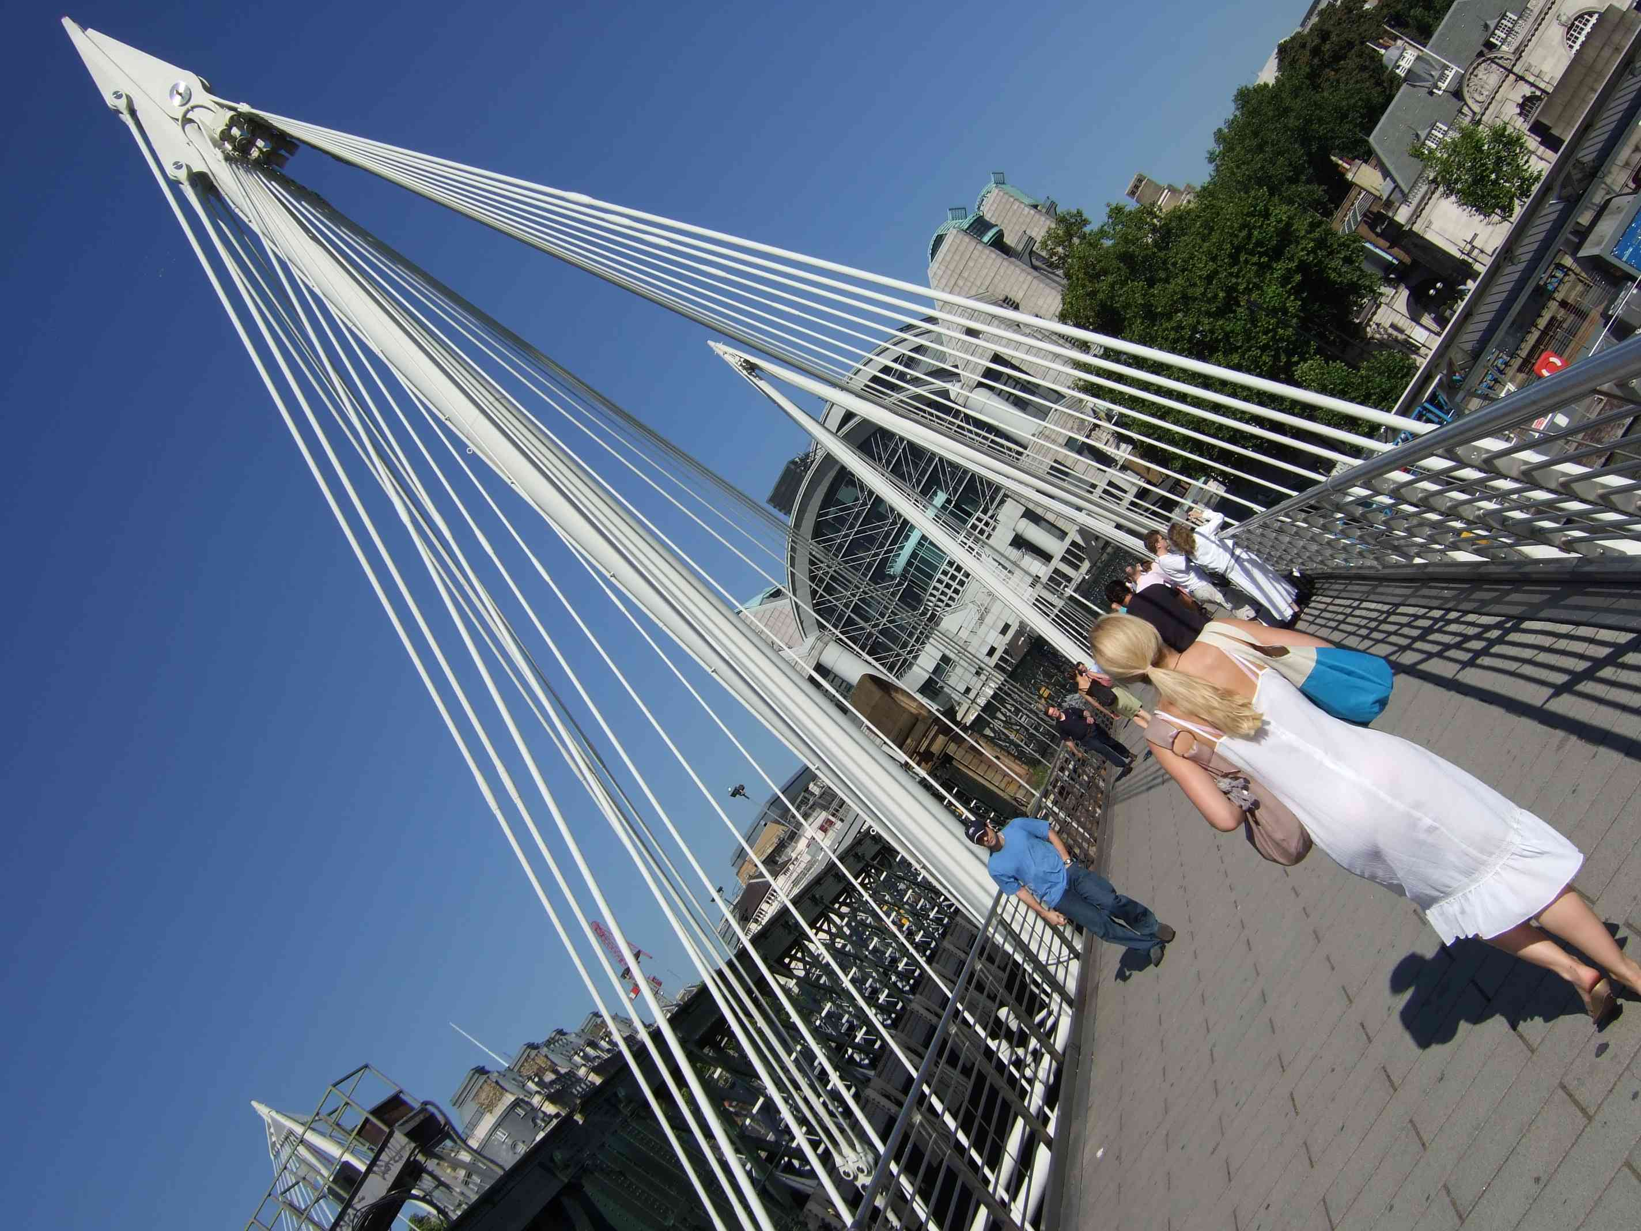
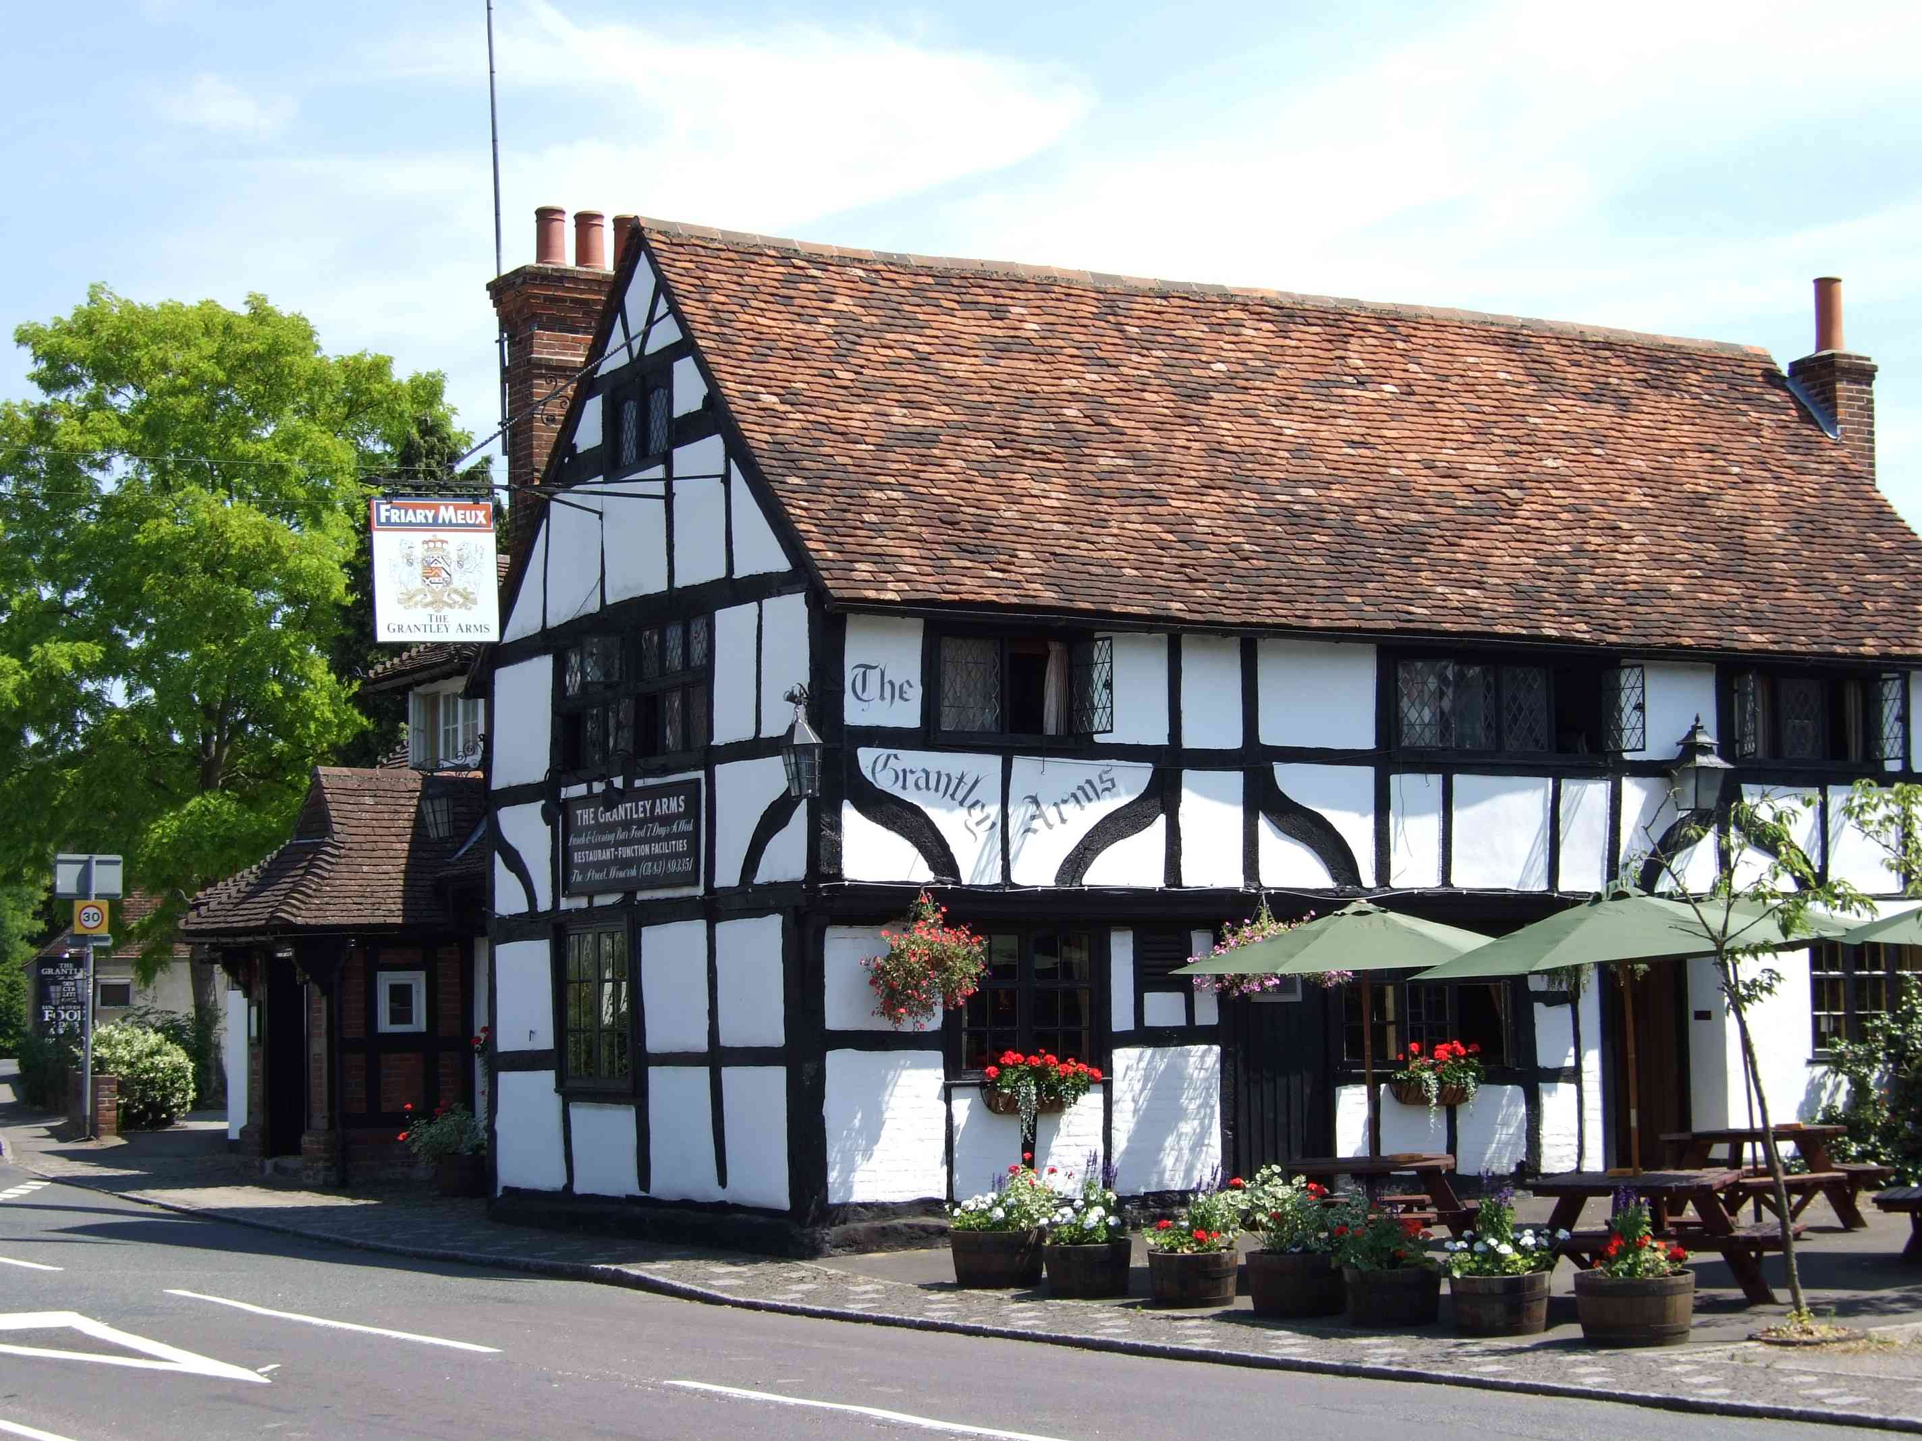
The Dataset
Camera models used:
Canon DIGITAL IXUS 990 IS (4000x3000)
Canon EOS D30 (2160x1440)
Canon IXY 30S (3648x2736)
FUJIFILM FinePix F30 (2848x2136)
FUJIFILM X30 (4000x3000)
iPhone 6S (4032x3024)

Slide 6
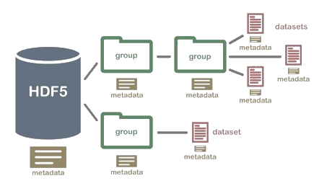
The FDH5 File
Patches overlapping (stride: 10)
Converted from RGB to grayscale
Convert image using JPEG compression
JPEG quality used: 31%
Organize camera models in groups
Clustering all patches of each image in a group

Slide 7
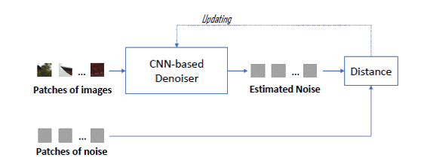
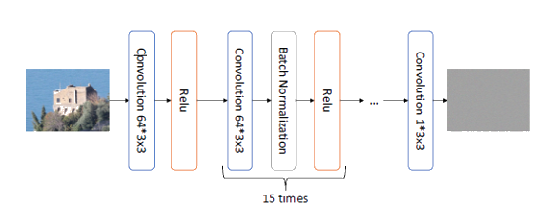
Structure: CNN-based Denoiser
CNN structure kept from AWGN (Additive White Gaussian Noise) Denoiser
Repeated layer groups composed of 64*3x3 convolutional layers + batch normalization and ReLu as activation function

Slide 8
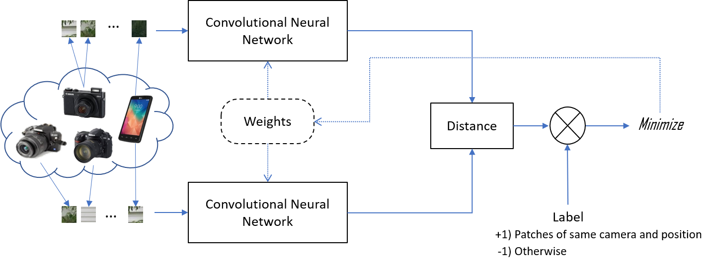
Siamese Network
Use of Siamese architecture as an abstraction to understand the pair of input and output.
Image patches coming from the same camera model should generate similar Noiseprint.
Noiseprint patches obtained from different positions and the same camera are different.
Positive labels whether same camera and position, otherwise, negative
Minibatches of 200 greyscale patches with dimension 40x40
Other parameters of the model:
Number of epochs: 200
Number of steps: 20
Learning rate: 0,0001
Number of groups (same camera and position) for batch: 50

Slide 9
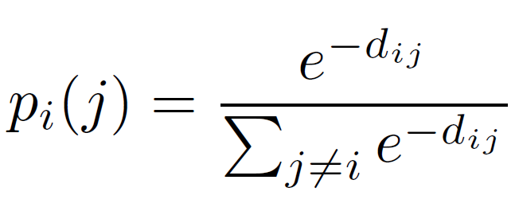
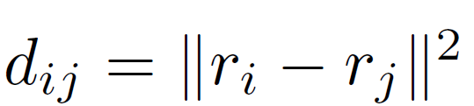
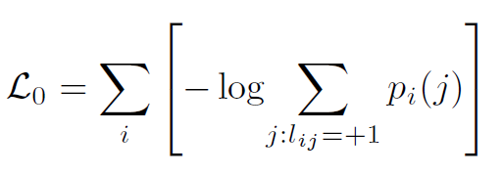
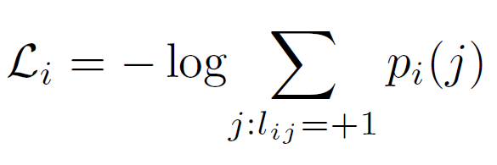
Training process
Residuals of the 2 input batches coming from the network
Distance evaluation:
Probability distribution:
Backpropagation and update of the weights
Using Adam optimizer
Minibatch loss
i-th patch loss

Slide 10

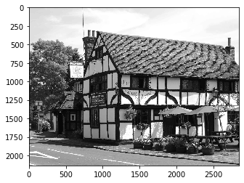
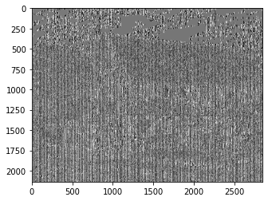
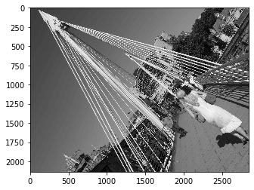
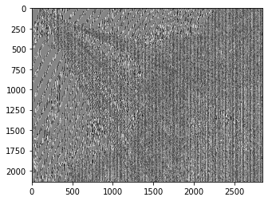
Qualitative Results
Notable details: artefacts generated from the jpeg compression.
Original image
Noiseprint result
Structural similarity
0,1183
0,1158

Slide 11
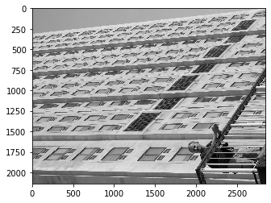
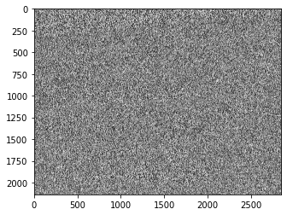
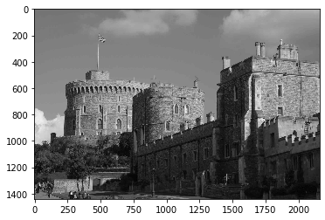
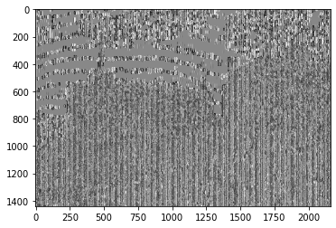
Qualitative Results
Original image
Noiseprint result
Structural similarity
0, 0673
0, 1600

Slide 12
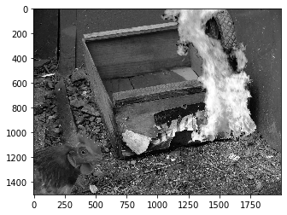
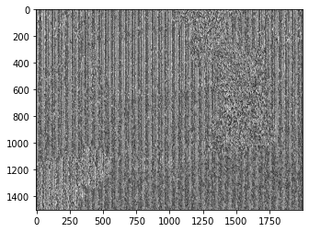
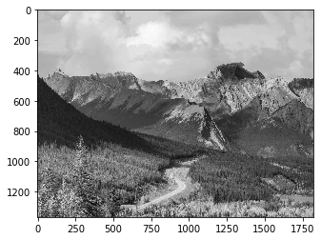
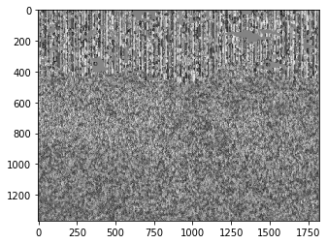
Qualitative Results
Notable details: different noise patterns in spliced images.
Original image
Noiseprint result
Structural similarity
0, 1167
0, 0753

Slide 13
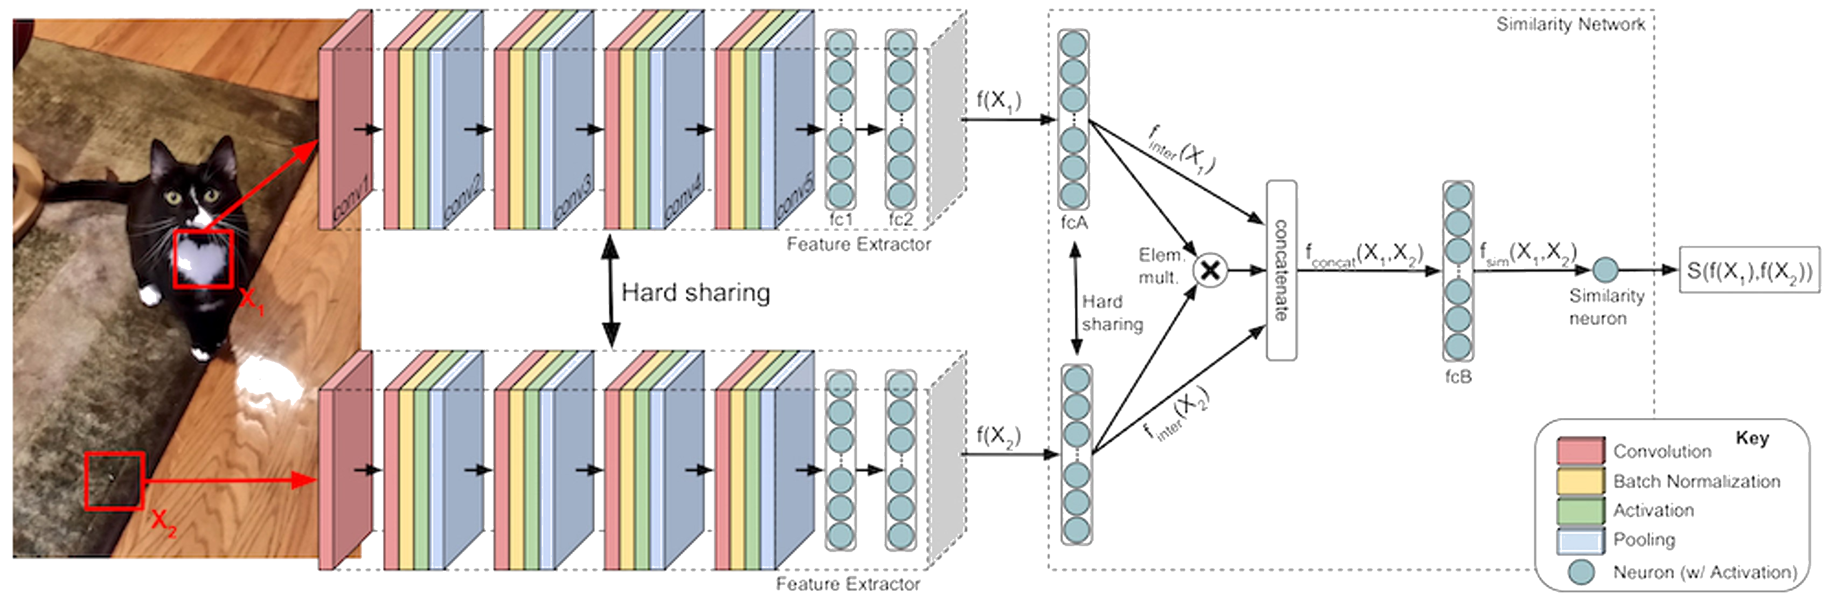
Image similarity Classifier
Detect whether an image is authentic or spliced
First part, extract features from each pair of patches
Second part, classify between the 2 classes.
threshold for classification: 0.73 (authentic ones have a greater probability than threshold, otherwise are spliced).

Slide 14
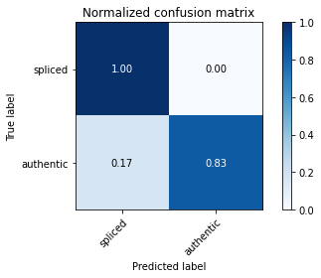
Quantitative results
Results from evaluation metrics:
Accuracy = 0.92
Precision = 1.0
Recall = 0.833
F1-score = 0.9
Matthews Correlation Coefficient (MCC) = 0.84
Average Precision = 0.92

Slide 15
Thank you for your attention!
The End

